Slide 1

Modern Database Management
Thirteenth Edition
Chapter 5
Introduction to S Q L Cont. ..
Copyright © 2019, 2016, 2013 Pearson Education, Inc. All Rights Reserved
Notes:
If this PowerPoint presentation contains mathematical equations, you may need to check that your computer has the following installed:
1) MathType Plugin
2) Math Player (free versions available)
3) NVDA Reader (free versions available)

Slide 2
Learning Objectives
5.1 Define terms
5.2 Interpret the history and role of S Q L in database development
5.3 Define a database using the S Q L data definition language
5.4 Write single-table queries using S Q L commands
5.5 Establish referential integrity using S Q L
5.6 Discuss the S Q L:1999 and S Q L:2016 standards

Slide 3

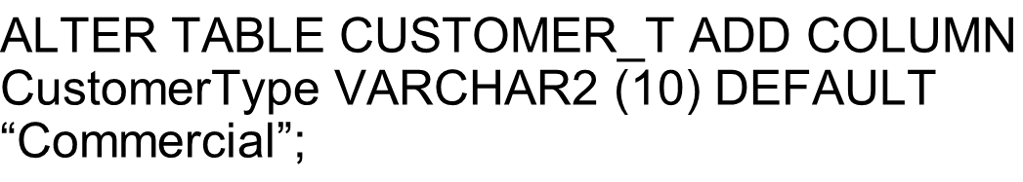
Changing Tables
ALTER TABLE statement allows you to change column specifications:
,
Table Actions:
,
,
Example (adding a new column with a default value):
,
Notes:
The ALTER command will be done after tables have already been created. For example, if you have an existing database, even one with actual data in it, you can modify tables by adding or changing columns, removing columns adding constraints, etc. If data in the tables violate the constraints, you will be prevented from setting these constraints until after changing the data.
So, whereas CREATE TABLE is mostly a process that takes place during implementation, ALTER TABLE often takes place during maintenance.

Slide 4

Removing Tables
DROP TABLE statement allows you to remove tables from your schema:
,
Notes:
Tables will not be dropped if there are other tables that depend on them. This means that if any table has a foreign key to the table being dropped, the drop will fail. Therefore, it makes a difference in which order you drop the tables.

Slide 5
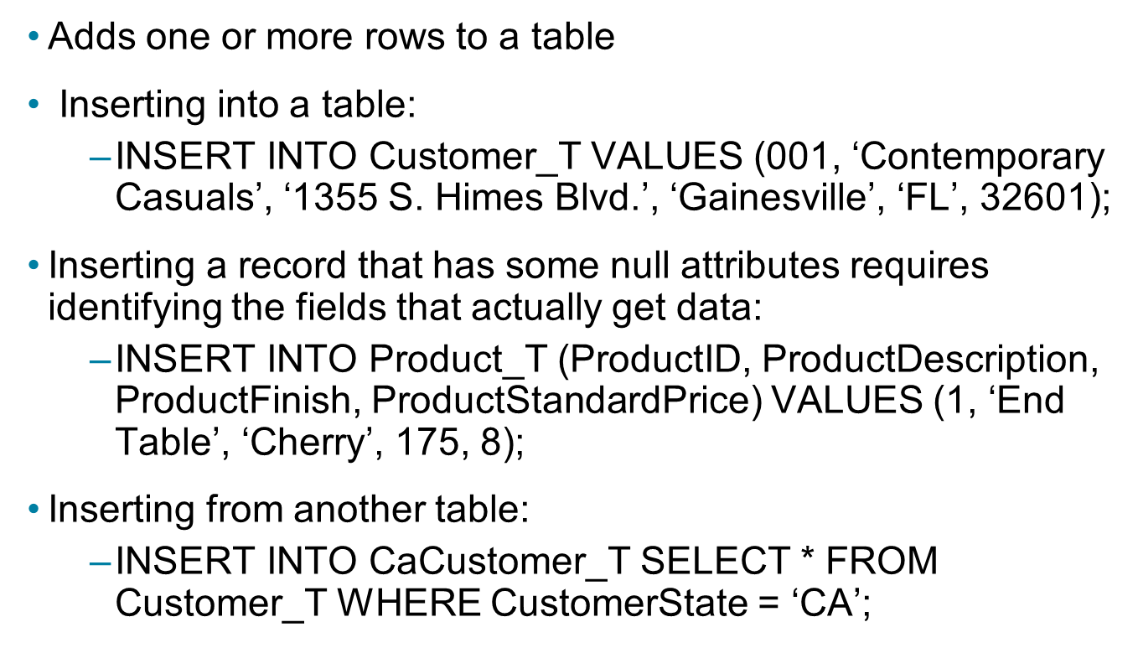
INSERT Statement
Adds one or more rows to a table
Inserting into a table:
,
Inserting a record that has some null attributes requires identifying the fields that actually get data:
,
Inserting from another table:
,
Notes:
As the last statement shows, it is possible to insert data into one table based on a query from another table. We’ll talk more about the SELECT statement shortly.

Slide 6
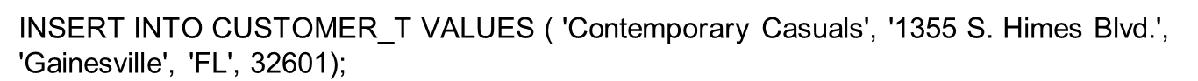
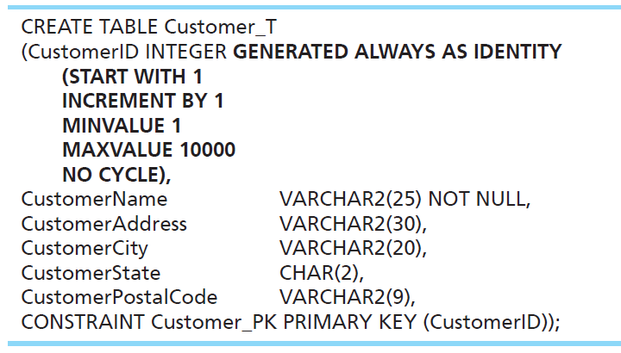
Creating Tables with Identity Columns
Inserting into a table does not require explicit customer I D entry or field list.
/* Replace varchar2 with varchar */
Notes:
Identity columns were introduced with SQL:2008. These are columns whose value automatically increment with each new INSERT. So, an INSERT statement does not explicitly give a value for an identity column; this is handled automatically. Often primary keys are identity columns, but not always.
CREATE TABLE Customer_T
(CustomerID INTEGER GENERATED ALWAYS AS IDENTITY
(START WITH 1
INCREMENT BY 1
MINVALUE 1
MAXVALUE 10000
NO CYCLE),
CustomerName VARCHAR2(25) NOT NULL,
CustomerAddress VARCHAR2(30),
CustomerCity VARCHAR2(20),
CustomerState CHAR(2),
CustomerPostalCode VARCHAR2(9),
CONSTRAINT Customer_PK PRIMARY KEY (CustomerID));

Slide 7
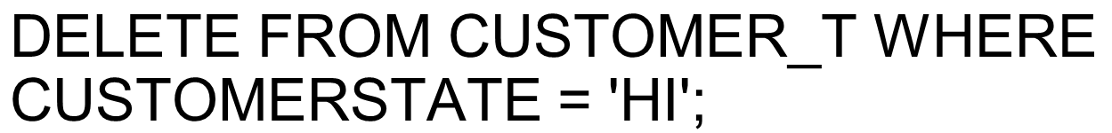

DELETE Statement
Removes rows from a table
Delete certain rows
,
Delete all rows
,
Notes:
Remember, referential integrity rules will control whether a delete actually happens.
The RESTRICT, CASCADE, and SET NULL constraints will determine how to handle the orders for a deleted customer.

Slide 8
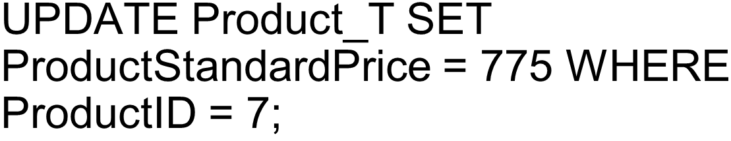
UPDATE Statement
Modifies data in existing rows
Notes:
For this UPDATE, we know that it will affect only one record in the table. How do we know this?
Answer: Because ProductID is the primary key, which must be unique. So, there can be only one product with ProductID = 7.
However, many times updates and deletes affect many records. For example,
DELETE FROM CUSTOMER_T WHERE CUSTOMERSTATE = 'HI'; affects all customers from Hawaii.

Slide 9
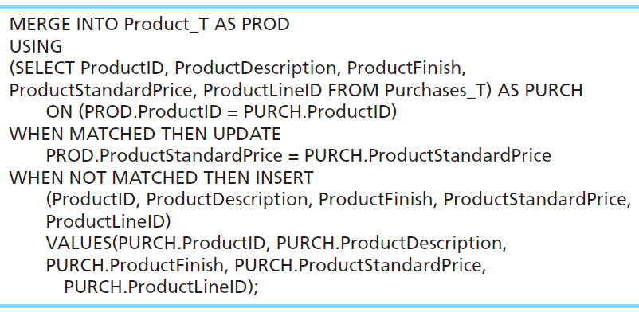
MERGE Statement
Makes it easier to update a table. It allows combination of Insert and Update in one statement.
Useful for updating master tables with new data.
Notes:
The MERGE statement was introduced in SQL:2008 to makes updating a table easier. Many database applications need to update master tables with new data. A Purchases_T table, for example, might include rows with data about new products and rows that change the standard price of existing products. Updating Product_T can be accomplished by using INSERT to add the new products and UPDATE to modify ProductStandardPrice in an SQL:1999 DBMS. SQL:2008 compliant DBMSs can accomplish the update and the insert in one step by using MERGE. The MERGE is based on a query (SELECT), and performs UPDATEs on matched records and INSERTS on unmatched.
MERGE INTO Product_T AS PROD
USING
(SELECT ProductID, ProductDescription, ProductFinish,
ProductStandardPrice, ProductLineID FROM Purchases_T) AS PURCH
ON (PROD.ProductID = PURCH.ProductID)
WHEN MATCHED THEN UPDATE
PROD.ProductStandardPrice = PURCH.ProductStandardPrice
WHEN NOT MATCHED THEN INSERT
(ProductID, ProductDescription, ProductFinish, ProductStandardPrice,
ProductLineID)
VALUES (PURCH.ProductID, PURCH.ProductDescription,
PURCH.ProductFinish, PURCH.ProductStandardPrice,
PURCH.ProductLineID);

Slide 10
Schema Definition
Control processing/storage efficiency:
Choice of indexes
File organizations for base tables
File organizations for indexes
Data clustering
Statistics maintenance
Creating indexes
Speed up random/sequential access to base table data
Example
,
This makes an index for the CUSTOMERNAME field of the
Notes:
All of this has to do with physical database design.

Slide 11
SELECT Statement
Used for queries on single or multiple tables
Clauses of the SELECT statement:
SELECT: List the columns (and expressions) to be returned from the query
FROM: Indicate the table(s) or view(s) from which data will be obtained
WHERE: Indicate the conditions under which a row will be included in the result
GROUP BY: Indicate categorization of results
HAVING: Indicate the conditions under which a category (group) will be included
ORDER BY: Sorts the result according to specified criteria
Notes:
The SELECT statement includes many features that allow you to perform sophisticated queries. You can specify the conditions for rows to be included in the results, and you can choose which columns from these rows should be included. You can either get detailed data, or get aggregate results such as sums and averages. You also have many options in how to sort and format the results.

Slide 12
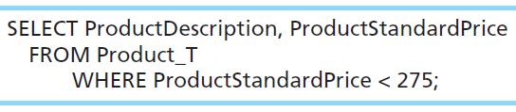
SELECT Example
Find products with standard price less than $275
Comparison operators include
= Equal to
> Greater than
>= Greater than or equal to
< Less than
<= Less than or equal to
<> Not equal to
!= Not equal to
Notes:
The WHERE clause includes one or more conditions. A condition is a test that for each row in the table is either true or false. Only those with true results are permitted in the result set of the query.
SELECT ProductDescription, ProductStandardPrice
FROM Product_T
WHERE ProductStandardPrice < 275;

Slide 13
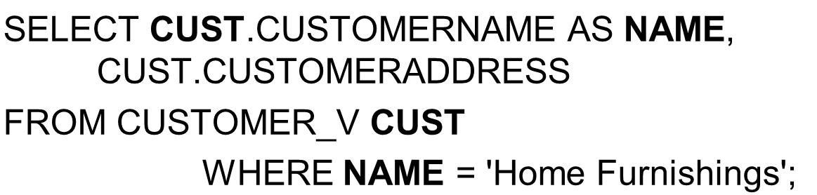
SELECT Example Using Alias
Alias is an alternative column or table name
Notes:
Aliases are useful. They can often save on typing time when writing a query.

Slide 14
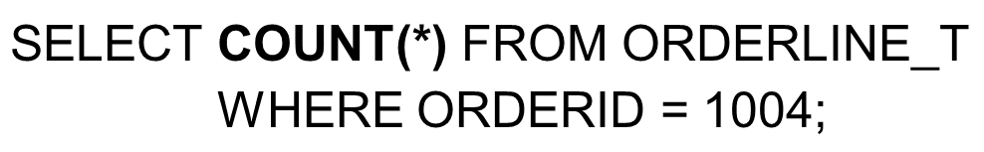
SELECT Example Using a Function
Using the COUNT aggregate function to find totals
Note: With aggregate functions you can’t have single-valued columns included in the SELECT clause, unless they are included in the GROUP BY clause.
Notes:
The most common aggregate functions are COUNT, SUM, and AVERAGE.
What the above query gives is a number indicating the total number of order line records associated with order number 1004.

Slide 15
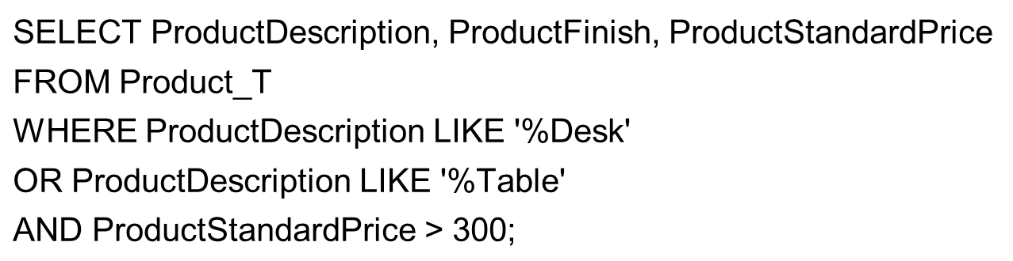
SELECT Example – Boolean Operators
AND, OR, and NOT Operators for customizing conditions in WHERE clause
Notes:
The WHERE clause in this query has tests for three conditions. It lists product name, finish, and standard price for (a) all desks, and (b) all tables that cost more than $300 in the Product table.
Note: The LIKE operator allows you to compare strings using wildcards. For example, the % wildcard in ‘%Desk’ indicates that all strings that have any number of characters preceding the word “Desk” will be allowed.
Note also: The AND logical operator processes before the OR operator.

Slide 16
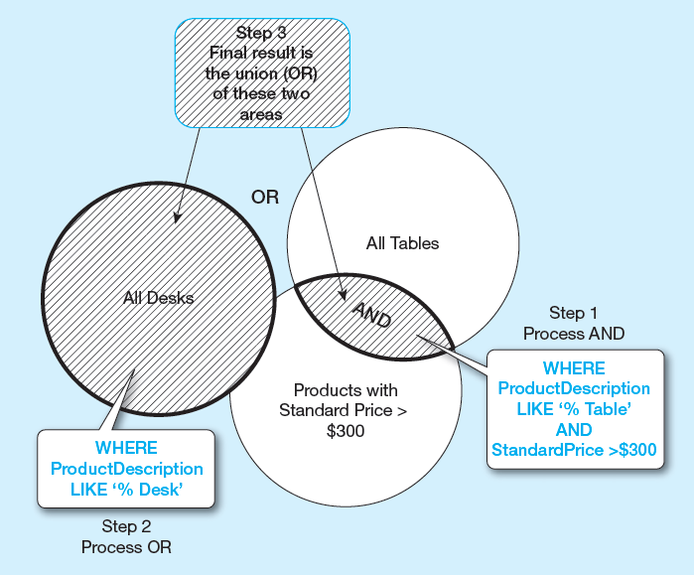
Figure 5-8 Boolean Query a Without Use of Parentheses
By default, processing order of Boolean operators is NOT, then AND, then OR
Notes:
By default, the AND operation takes place before the OR. So, only tables over $300 are included (via the AND). These are then combined with all desks (no matter what price) via the OR.

Slide 17
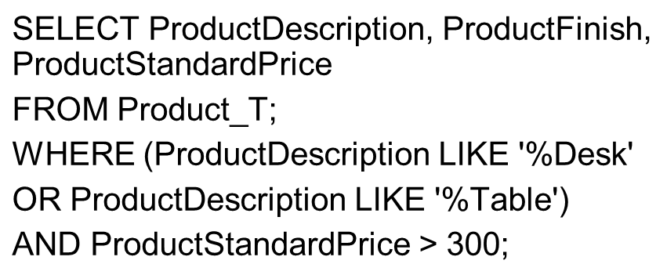
SELECT Example–Boolean Operators
With parentheses…these override the normal precedence of Boolean operators
With parentheses, you can override normal precedence rules. In this case parentheses make the OR take place before the AND.

Slide 18
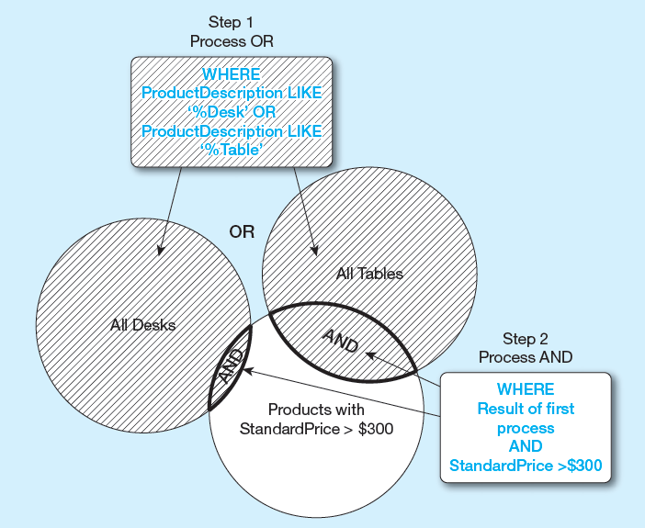
Figure 5-9 Boolean Query B with Use of Parentheses
With parentheses, you can override normal precedence rules. In this case parentheses make the OR take place before the AND.

Slide 19
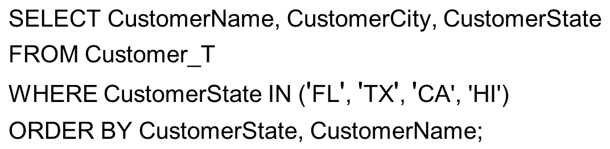
Sorting Results with ORDER BY Clause
Sort the results first by STATE, and within a state by the CUSTOMER NAME
Note: The IN operator in this example allows you to include rows whose CustomerState value is either F L, T X, C A, or H I. It is more efficient than separate OR conditions.
Notes:
You can order by any number of fields from the originating table.
Question: How would you have done the WHERE clause if you used OR conditions instead of the IN operator?
Answer: WHERE CustomerState = ‘FL’ OR CustomerState = ‘TX’ OR CustomerState = ‘CA’ OR CustomerState = ‘HI’

Slide 20
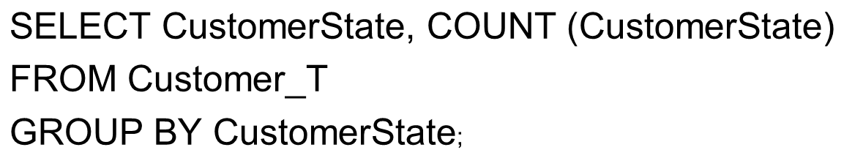
Categorizing Results Using GROUP BY Clause
For use with aggregate functions
Scalar aggregate: single value returned from S Q L query with aggregate function
Vector aggregate: multiple values returned from S Q L query with aggregate function (via GROUP BY)
You can use single-value fields with aggregate functions if they are included in the GROUP BY clause
Notes:
This is an example of vector aggregate. It will return the number of customers from each state. This query will return the name and count of customers from all states that actually have customers.
If all we wanted was the total number of customers (across all states), we could do this scalar aggregate query:
SELECT COUNT(*) from Customer_T
This query will return a single value, which is the total number of customers. That would be the sum of all the individual numbers returned from the aggregate query displayed in this slide.

Slide 21
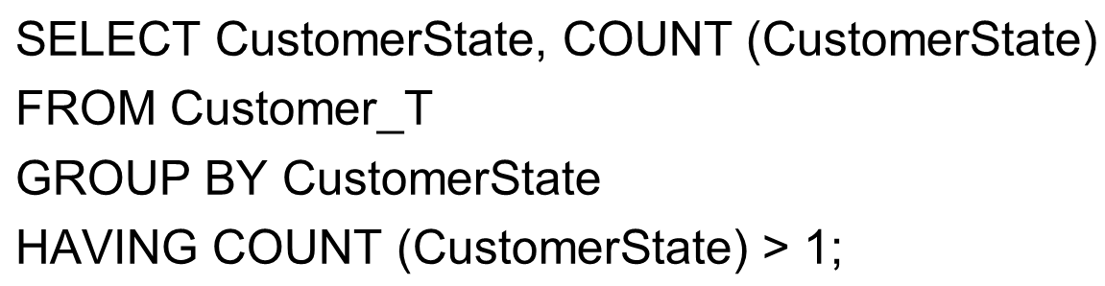
Qualifying Results by Categories Using the HAVING Clause
For use with GROUP BY
Like a WHERE clause, but it operates on groups (categories), not on individual rows. Here, only those groups with total numbers greater than 1 will be included in the final result.
Notes:
The HAVING clause restricts which groups will be returned in a vector aggregate query. It’s like a WHERE clause, but operates on groups, not individual rows.

Slide 22
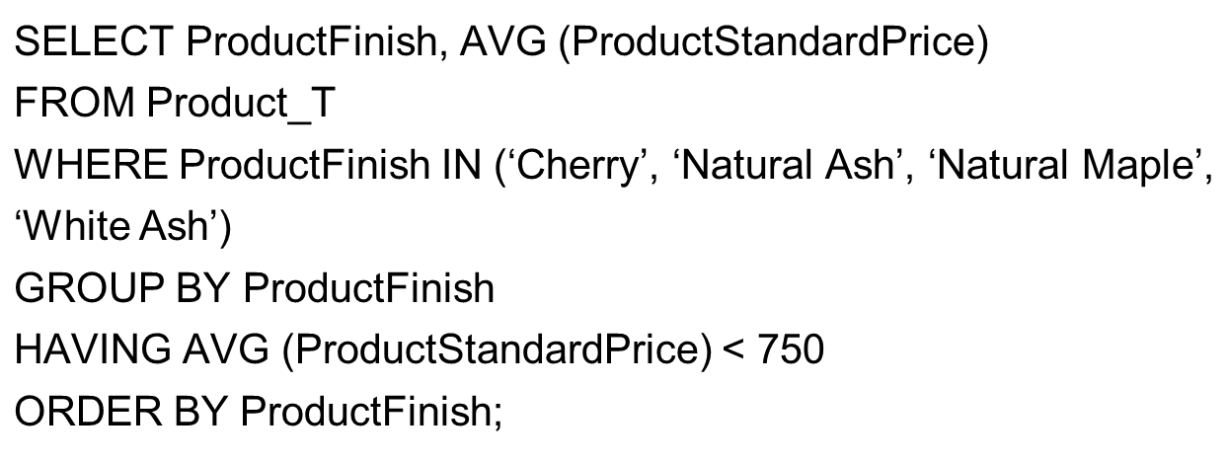
A Query with Both WHERE and HAVING
Notes:
First, the WHERE clause restricts us to only products with certain types of Product Finish. Then, after that they are grouped by the product finish and average prices calculated for each group. Only the groups with average price less than $750 are included in the final result, via the HAVING clause. After all this is done, they are ORDERed alphabetically by ProductFinish.
So, the WHERE clause operated to restrict the number of rows, and then the HAVING clause was used to restrict the number of groups.

Slide 23
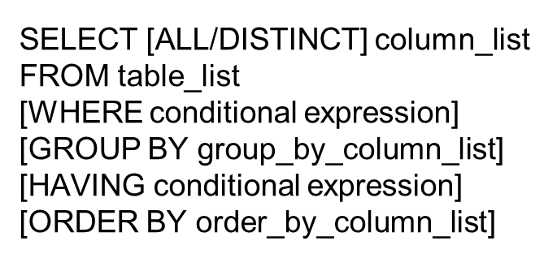
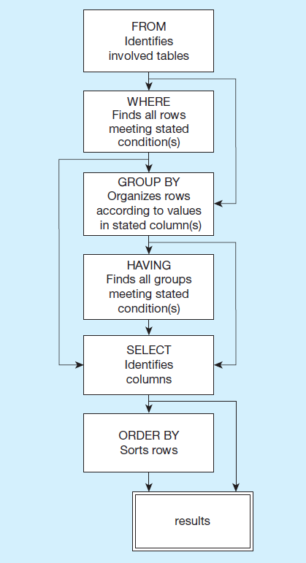
Figure 5-10 S Q L Statement Processing Order
(based on van der Lans, 2006, p. 100)
Notes:
The SELECT clause specifies which columns to return. The FROM clause specifies which tables these come from. The WHERE clause specifies conditions that determine whether a row is returned in the results. GROUP BY and HAVING are used for aggregate queries and ORDER BY determines sorting. Note that queries can also include subqueries, so you may see a SELECT inside another SELECT.

Slide 24

Copyright

